Slide 1
Auto-Encoding Scene Graphs for Image Captioning
School of Computer Science and Engineering,
Nanyang Technological University
CVPR2019

Slide 2
Intuition & Problem
Intuition
“person on bike” -> replace “on” with “ride”
-> “person riding bike on a road”
We humans use the inductive bias (common sense knowledge, language prior) to compose collocations and contextual inference in discourse.
Exploiting such bias is expected to help models less likely overfit to the dataset bias and focus on reasoning.
Notes:
For example, when we see the relation “person on bike”, it is natural to replace “on” with “ride” and infer “person riding bike on a road” even the “road” is not evident.

Slide 3
Intuition & Problem
Problem
unseen image scene -> simple and trivial caption
e.g. “there is a dog on the floor”, just a list of object detection.
The direct exploitation of the inductive bias, e.g., early template/rule-based caption models, is well-known ineffective compared to the encoder-decoder ones, due to the large gap between visual perception and language composition (this paper use scene graphs to bridge the gap.).
Notes:
When we feed an unseen image scene into the framework, we usually get a simple and trivial caption about the salient objects such as “there is a dog on the floor”, which is no better than just a list of object detection.

Slide 4
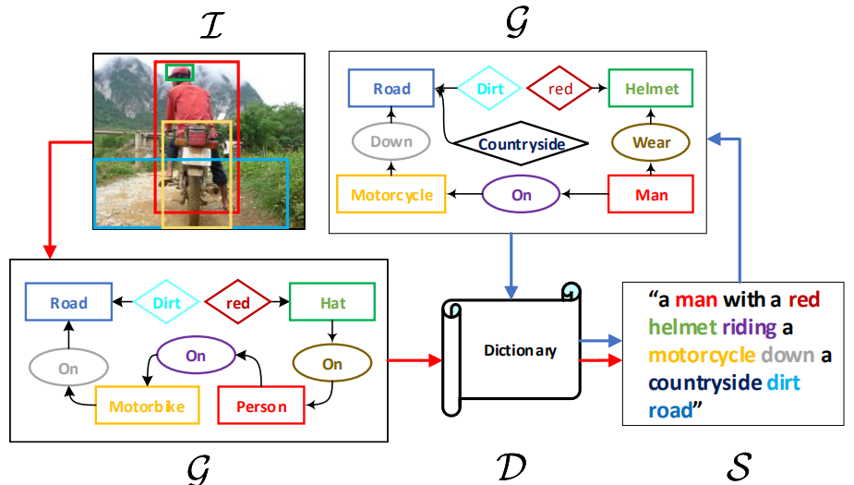
Overview
Two ways
reconstruct sentences:
S → G → D → S
to learn a dictionary D (the inductive bias)
Image captioning:
I → G → D → S
use the shared D transfer the inductive bias from the pure language domain to the vision-language domain.

Slide 5
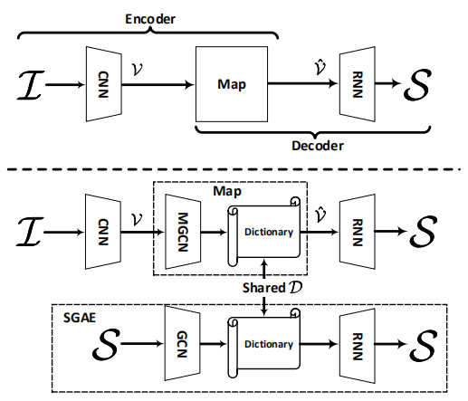
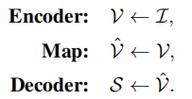
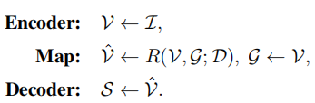
Comparison
Conventional encoder-decoder:
Map: attention mechanism
Newly proposed framework:

Slide 6
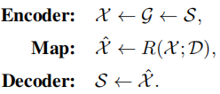
Auto-Encoding Scene Graphs
Learn D through self-reconstructing sentence S
Definition of Graph:
G = (N , E)
N: object node o_{i}, attribute node a_{i,l}, and relationship node r_{ij}
represented by a d-dimensional vector, i.e., e_{o}, e_{a}, and e_{r}.
E: from a_{i,l} to o_{i}; relationship triplet < o_{i} - r_{ij} - o_{j} >,
two directed edges from oi to rij and from rij to oj

Slide 7
Auto-Encoding Scene Graphs
G ← S
use the scene graph parser provided by SPICE (An evaluation metric) for scene graphs G from sentences: a syntactic dependency tree is built and then a rule-based method is applied for transforming the tree to a scene graph.
X ← G
to transform the original node embeddings into a new set of context-aware embeddings X, which contains three embedded representations corresponding to the three nodes

Slide 8
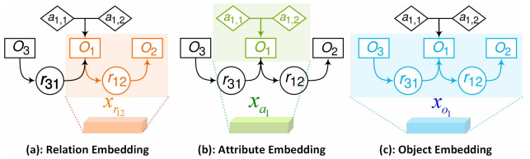

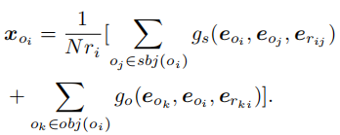

Auto-Encoding Scene Graphs
use four spatial graph convolutions for generating X.
Notes:
same structure with independent parameters: a vector concatenation input to a fully-connected layer, followed by an ReLU.

Slide 9


Auto-Encoding Scene Graphs
Map
Decoder
deploy the attention structure (Up-Down) for reconstructing S.
objective: MLE and RE
x ∈ X, α be viewed as the “key”

Slide 10
Overall Model SGAE-based EncoderDecoder
Multi-modal Graph Convolution Network
use Faster-RCNN as the object detector, MOTIFS relationship detector as the relationship classifier, and we use our own attribute classifier: an small fc-ReLU-fc-Softmax network head.
Object Node representation: fuse the RoI features pre-trained from Faster RCNN and the detected label embedding.
u_{rij} and u_{ai} are obtained in a similar way.
Similar to the GCN, MGCN also has an ensemble of four, each of
which is a two-layer structure: fc-ReLU with independent parameters.

Slide 11
Overall Model SGAE-based EncoderDecoder
Train
use the SGAE pre-trained D as the initialization.
use the cross-entropy loss for 20 epochs and then use the RL-based reward for another 40 epochs.

Slide 12
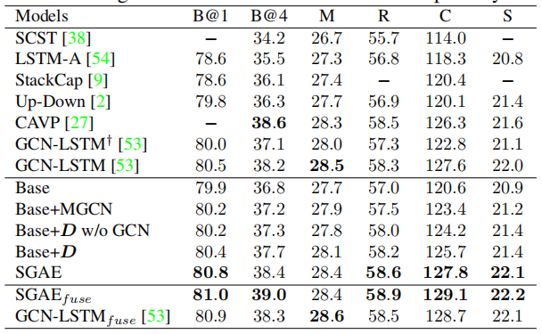
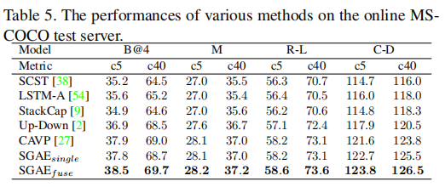
Results
on MS-COCO Karpathy split.

Slide 13
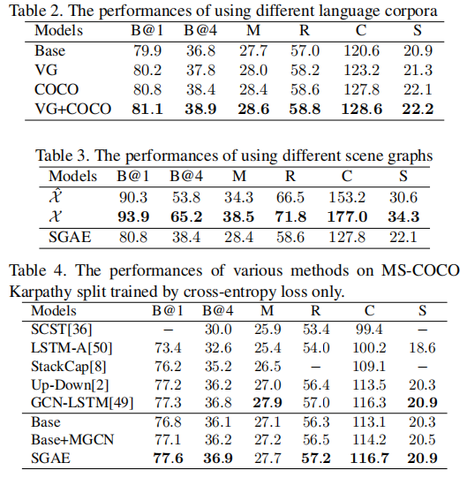
Results

